Slide 1


PORTFOLIO WEBSITE

Slide 2
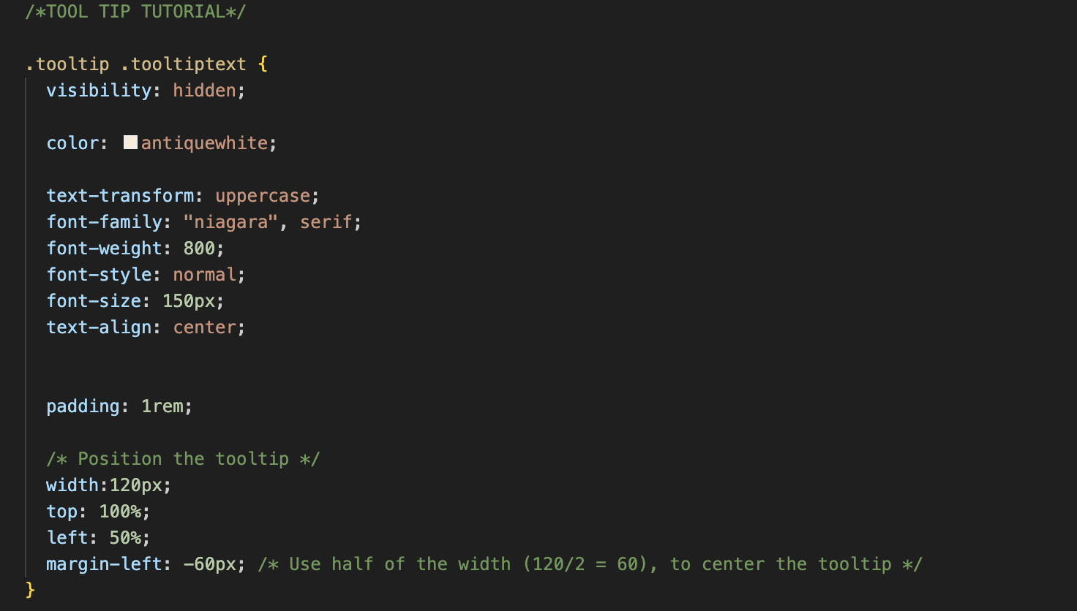
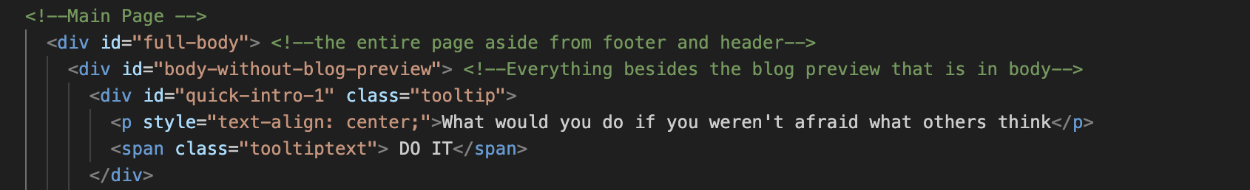
SNIPPET OF CODE // TUTORIAL EXPLANATION

Slide 3
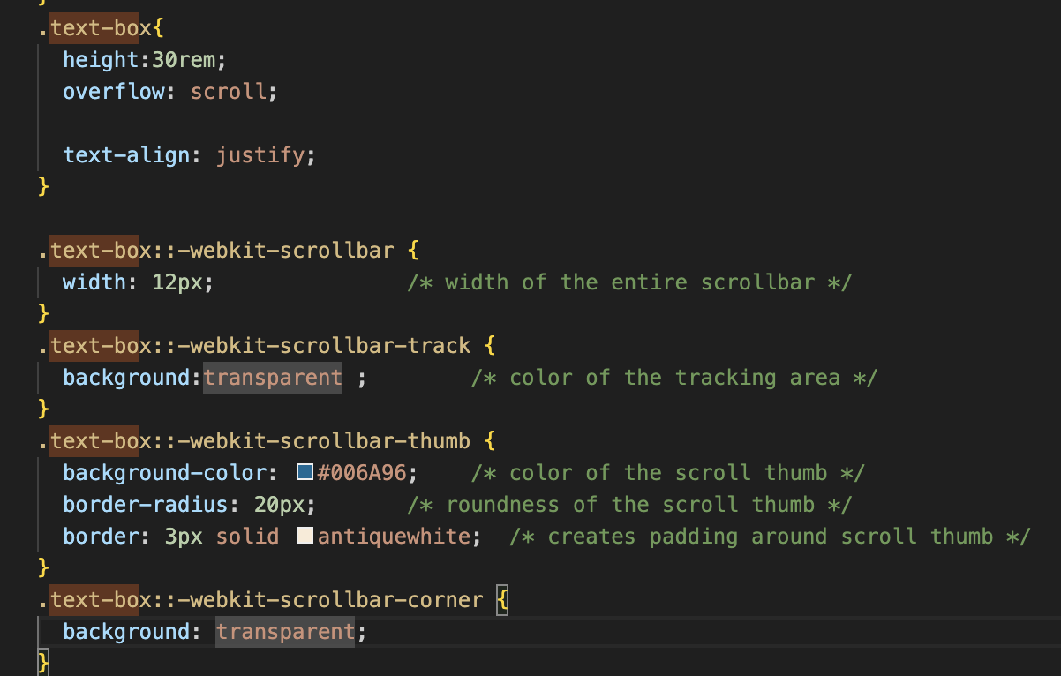

Slide 4
WHAT WILL I ADD?? IF I HAD MORE TIME….
EASTER EGGS WITH HOVERED LINKS THROUGHOUT THE SITE
INCLUDING MORE QUOTES AND “RANDOM” PIECES OF CONTENT
ADD PHOTOS AND ACTUAL BLOG PARAGRAPHS
ADD A GRAIN FILTER TO THE BACKGROUND
ADD MOVING IMAGES WITH JAVA

